Slide 2
Database
Database
is collection of related data and its metadata organized in a structured format
for optimized information management
Database Management System (DBMS)
is a software that enables easy creation, access, and modification of databases
for efficient and effective database management
Database System ( Database + DBMS)
is an integrated system of hardware, software, people, procedures, and data
that define and regulate the collection, storage, management, and use of data within a database environment
Notes:
End user data – raw facts of interests to the end user
Metadata – description of data characteristics and relationships
Organization of data helps:
improve data accuracy
improve timely access
correlation and comparison
DBMS: a collection of programs that manages the database structure, control access to data
- Makes data management more efficient and effective
- Query language allows quick answers to ad hoc queries
- Provides better access to more and better-managed data
- Promotes integrated view of organization’s operations
- Reduces the probability of inconsistent data

Slide 3
Data vs. Information
Data:
Raw facts; building blocks of information
Unprocessed information
Information:
Data when processed .
Knowledge :
Information when processed
Intelligence :
- Knowledge when processed

Slide 4
Database Systems
A database system consists of
Data (the database)
Software
Hardware
Users
We focus mainly on the software
Database systems allow users to
Store
Update
Retrieve
Organise
Protect
their data.

Slide 5
Database Users
End users
Use the database system to achieve some goal
Application developers
Write software to allow end users to interface with the database system
Database Administrator (DBA)
Designs & manages the database system
Database systems programmer
Writes the database software itself

Slide 6
Database Management Systems
A database is a collection of information
A database management system (DBMS) is the software than controls that information
Examples:
Oracle
DB2 (IBM)
MS SQL Server
MS Access
Ingres
PostgreSQL
MySQL

Slide 7
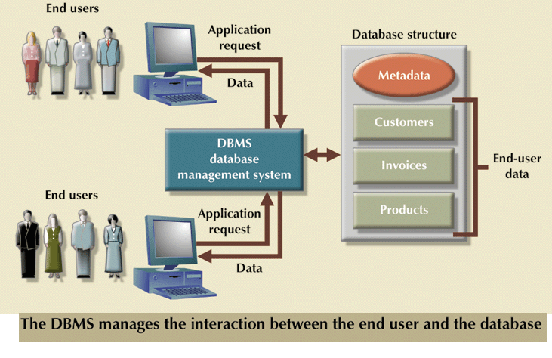
Role of DBMS

Slide 8
What the DBMS does
Provides users with
Data definition language (DDL)
Data manipulation language (DML)
Data control language (DCL)
Transaction control language (TCL)
Often these are all the same language
DBMS provides
Persistence
Concurrency
Integrity
Security
Data independence
Data Dictionary
Describes the database itself(table, views,indexes,users etc.)
Information about who is using which data (locks)
Schemas and mappings

Slide 9
File Based Systems
File based systems
Data is stored in files (collection of records)
Record (Collection of fields)
Each file has a specific format
File Organization
Sequential
Pointer
Indexed
Direct
Problems or Issues :
No standards
Data Redundancy
Data dependence
Data Inconsistency
No way to generate ad hoc queries
No provision for security, recovery, concurrency, etc.
Atomicity Problems

Slide 10
Purpose of DBMS
Data Independence and efficient access.
Data Integrity , Data Security , Data Consistency
Data Sharing
Reduced Data Redundancy
Uniform data administration.
Concurrent access.
Recovery from crashes.
Provides Multiple User Interface.
Represent Complex relationship among data
Reduced application development time.
Notes:
3

Slide 11
Database Views
External schema or view schema describes how users see the data.
( database users )
Conceptual schema or Logical Schema defines logical structure
of database. ( data with relationship)
(database designers and database administrators)
Physical schema or Internal Schema describes how the data is stored.
(System Designers)
View 1
View 2
View 3
Conceptual Schema
Physical Schema
Schemas are defined using DDL; data is modified/queried using DML.
Notes:
6

Slide 12
Internal Level
Deals with physical storage of data
Structure of records on disk - files, pages, blocks
Indexes and ordering of records
Used by database system programmers
Internal Schema
RECORD EMP
LENGTH=44
HEADER: BYTE(5)
OFFSET=0
NAME: BYTE(25)
OFFSET=5
SALARY: FULLWORD
OFFSET=30
DEPT: BYTE(10)
OFFSET=34

Slide 13
Conceptual Level
Deals with the organisation of the data as a whole
Abstractions are used to remove unnecessary details of the internal level
Used by DBAs and application programmers
Conceptual Schema
CREATE TABLE
Employee (
Name
VARCHAR(25),
Salary REAL,
Dept_Name
VARCHAR(10))

Slide 14
External Level
Provides a view of the database tailored to a user
Parts of the data may be hidden
Data is presented in a useful form
Used by end users and application programmers
External Schemas
Payroll:
String Name
double Salary
Personnel:
char *Name
char *Department

Slide 15
Mappings
Mappings translate information from one level to the next
External/Conceptual
Conceptual/Internal
These mappings provide data independence
Physical data independence
Changes to internal level shouldn’t affect conceptual level
Logical data independence
Conceptual level changes shouldn’t affect external levels

Slide 16
ANSI/SPARC Architecture
User 1
User 2
User 3
External
View 1
External
View 2
External Schemas
External/Conceptual Mappings
Conceptual
View
DBA
Conceptual Schema
Conceptual/Internal Mapping
Stored
Data
Internal Schema

Slide 17
Types of Data Models
Hierarchical
Network
Relational
Entity relationship
Object oriented

Slide 18
Evolution of Major Data Models

Slide 19
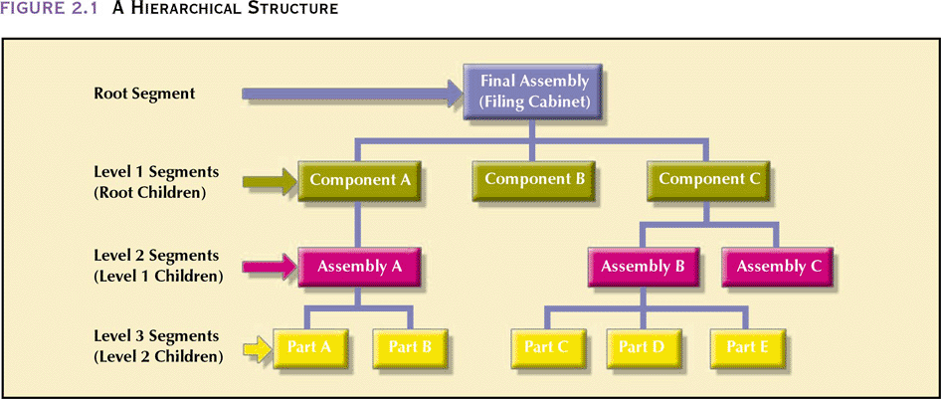

Slide 20
The Network Model
Created to
Represent complex data relationships more effectively
Improve database performance
Impose a database standard
Conference on Data Systems Languages (CODASYL)
American National Standards Institute (ANSI)
Database Task Group (DBTG)

Slide 21
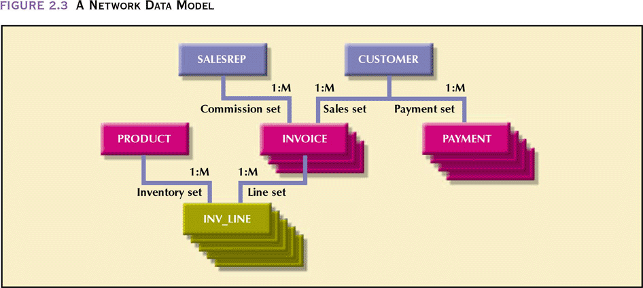

Slide 22
The Network Data Model
Advantages
Conceptual simplicity
Handles more relationship types
Data access flexibility – no need for a preorder traversal
Promotes database integrity – must first define the owner and then the member record
Data independence
Conformance to standards

Slide 23
The Network Data Model (continued)
Disadvantages
System complexity
Lack of structural independence

Slide 24
The Relational Model
Developed by Codd (IBM) in 1970
Considered ingenious but impractical in 1970
Conceptually simple
Computers lacked power to implement the relational model
Today, microcomputers can run sophisticated relational database software

Slide 25
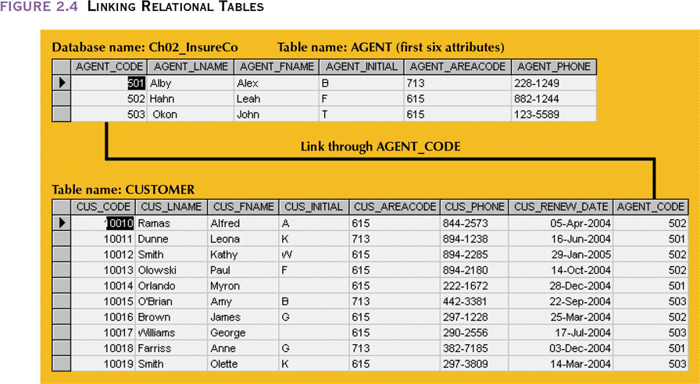
Linking Relational Tables

Slide 26
The Relational Model
Advantages
Structural independence – changes in the relational data structure do not affect the DBMS’s data access in any way
Improved conceptual simplicity by concentrating on the logical view
Easier database design, implementation, management, and use
Ad hoc query capability - SQL
Powerful database management system

Slide 27
The Relational Model (continued)
Disadvantages
Substantial hardware and system software overhead
Can facilitate poor design and implementation
May promote “islands of information” problems

Slide 28
The Entity Relationship Model
Widely accepted and adapted graphical tool for data modeling
Introduced by Peter Chen in 1976
Graphical representation of entities and their relationships in a database structure

Slide 29
The Entity Relationship Model
Advantages
Exceptional conceptual simplicity
Visual representation
Effective communication tool
Integrated with the relational data model

Slide 30
The Entity Relationship Model
Disadvantages
Limited constraint representation
Limited relationship representation
No data manipulation language
Loss of information content

Slide 31
Object Oriented Data Model— Basic Structure
Object: abstraction of a real-world entity
Attributes describe the properties of an object
Objects that share similar characteristics are grouped in classes
Classes are organized in a class hierarchy
Inheritance is the ability of an object within the class hierarchy to inherit the attributes and methods of classes above it

Slide 32
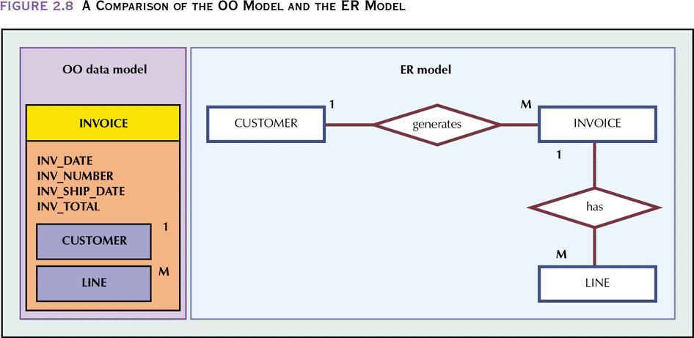
A Comparison of the OO Model and the ER Model

Slide 33
The Object Oriented Model
Advantages
Adds semantic content
Visual presentation includes semantic content
Database integrity
Both structural and data independence

Slide 34
The Object Oriented Model (continued)
Disadvantages
Slow pace of OODM standards development
Complex navigational data access
Steep learning curve
High system overhead slows transactions
Lack of market penetration

Slide 35
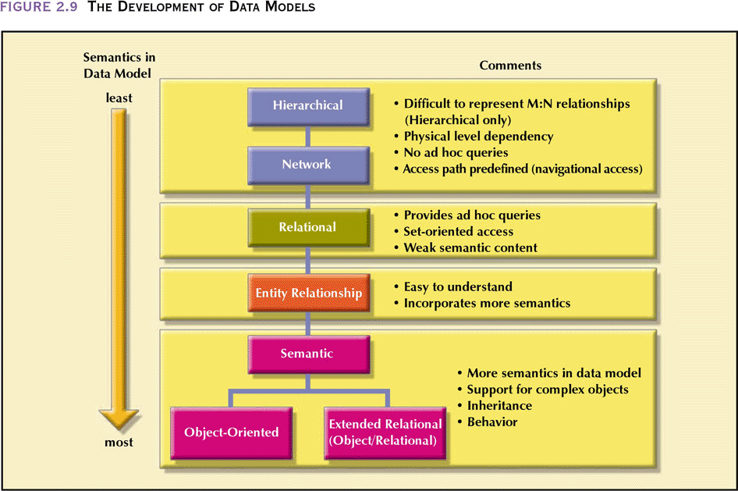
The Development of Data Models

